Slide 1
Azubi Africa Cloud Computing Project 2
Team Sublime Presentation

Slide 2

Team Members
Amos Mogaka Nyaburi
Brian Gitau
Christopher Yongo
Ebenezer Kuku
Emmanuel Bassey
Ifeanyi Okeibunor
Eva Naomi Njoroge
Nana Esi Ashun-Cobbina
Uwimana Alphonsine

Slide 4
AWS DynamoDB
Amazon DynamoDB is a key-value and document database that delivers single digit millisecond performance at scale.
In this project we are going to demonstrate how to use terraform to create AWS dynamoDb tables, use php-composer to dynamically populate html table.
There after, containerize our application in docker.

Slide 5
Php-Composer
Is a dependency manager for PHP.
It also has its own autoloader to enable autoloading.
1. Download composer https://getcomposer.org
Make composer globally or locally.
Require your first package.
2. Create a composer.json file will declare to composer the vendor name you would like to install
composer.lock will point to the version currently installed.
Composer Install
This looks for a Composer.lock file exists, if none exists, “composer update” will automatically run to create the Composer.lock file. If Composer.lock file exists, then install the declared dependencies from here (working directory).

Slide 6
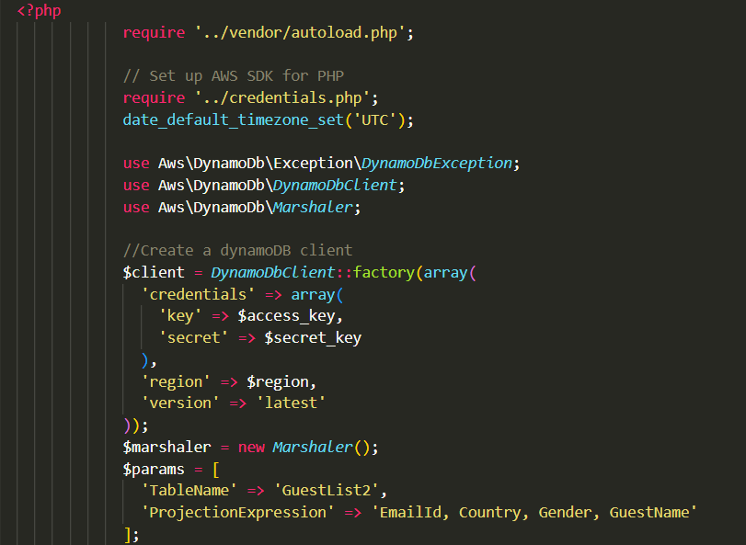
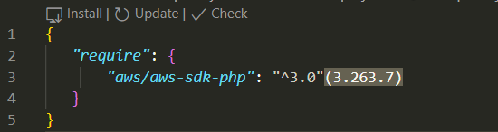
- Run composer require vendor/aws/aws-sdk-php
- Vendor folder where composer downloads all the packages/project dependencies.

Slide 7
Terraform to create DynamoDb table
Terraform is an open source infrastructure as code software tool that provides a consistent CLI workflow to manage hundreds of cloud services (resources). Terraform codifies cloud APIs into declarative configuration files. Not specific to cloud provider.
Basic Terraform Commands {
terraform init – initialize the plugin as per the code
terraform fmt – neatly formats the terraform code
terraform plan – highlights on the code to be implemented and whether the configurations are correct
terraform apply – applies/runs the code to create our resources
terraform destroy - to kill and remove all the code and infrastructure build. Totally remove the programs built by terraform.
}
Configure Aws account to allow programmatic access and access to DynamoDb.
Obtain the secret keys and access ID. Store them in a separate file locally.

Slide 8
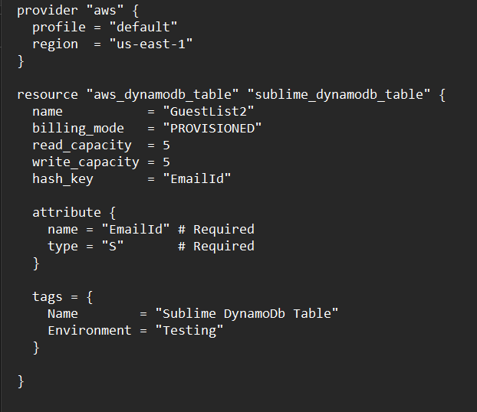
Sample terraform codes
Create a terraform .tf file and put in the project dependencies
- In this case the
Provider – specify the provider(AWS)
Resource we want to use
Resource attributes
In another file to keep it much readable create

Slide 9
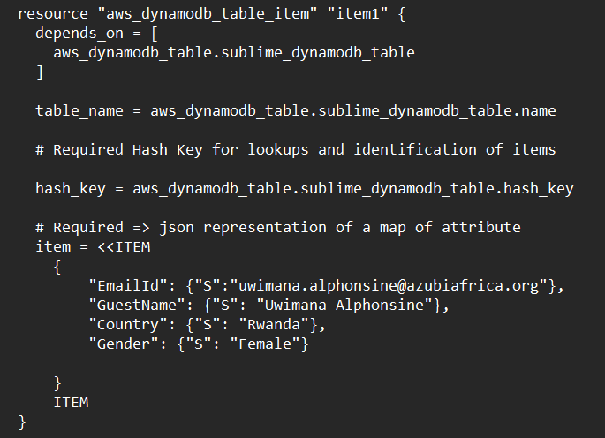
Inserting items to DynamoDb table
This sample code inserts items to DynamoDB one at a time.
To insert a second item add another table item using the same code changing “item1” to “item2” and the table item attributes.

Slide 10
Dockerization of the application
Just three simple steps to push image to docker hub:
docker login --username username
prompts for password if you omit --password which is recommended as it doesn't store it in your command history.
docker tag my-image username/my-repo.
docker tag docker-web-app:3.0 username/docker-web-app:3.0
docker push username/my-repo.
docker push username/docker-web-app:3.0

Slide 11
The End.

